Slide 1
tSNE
T-distribution Stochastic Neighbor Embedding

Slide 2
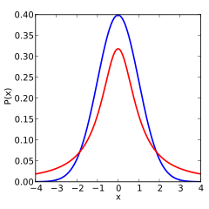
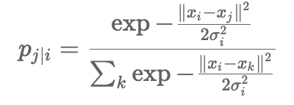
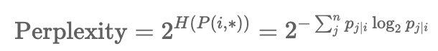
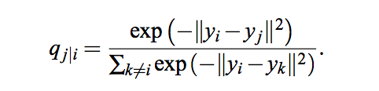
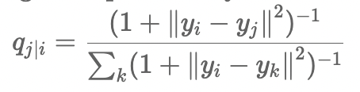
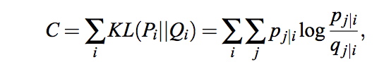
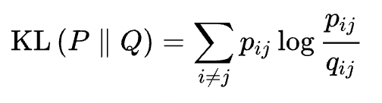
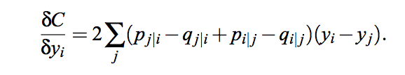
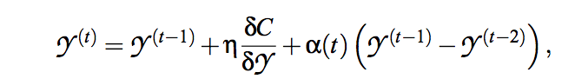
t-SNE Algorithm
1.compute Markov matrix
Gaussian Distribution: high dim
T-distribution: low dim
High dimensional Neighbor probabilities (Gaussian kernel)
bandwidth σ calculated from perplexity
Low dimensional Neighbor probabilities (t distribution df =1)
SNE use Gaussian kernel
2.compute loss: KL Divergence
3. use SGD to optimize

Slide 3
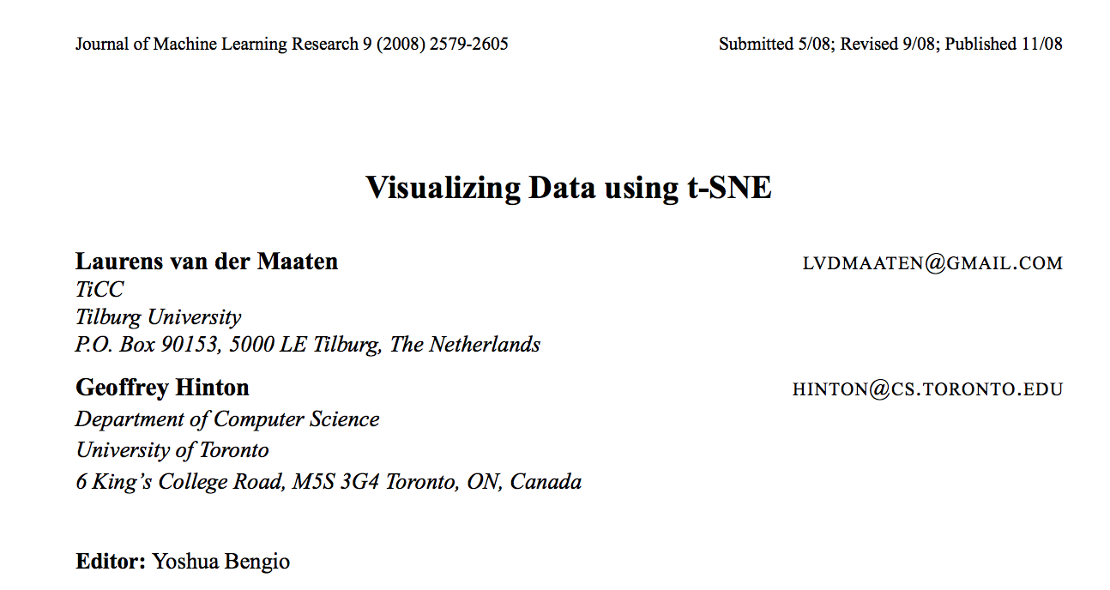

Slide 4
High dimensional space (input)
Low dimensional space (output)
j
i
j
i
Compute Markov-normalized affinity matrix in high dimensions P, and low dimensions Q
Greedily move low dimensional points so that for any point i entries of P(i,*) match Q(i,*)
Repeat
Notes:
The result is a two dimensional map that …..

Slide 5

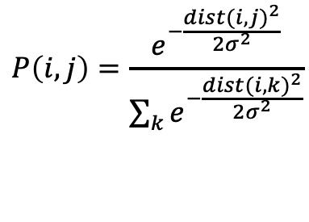
Distances to Affinities
Which neighbor do I visit next?
Uses a Markov-normalized affinity matrix P
2
3
$$P\left(i,j\right)=\frac{e^{−\frac{{dist(i,j)}^{2}}{2σ^{2}}}}{\sum_{k}{e^{−\frac{{dist(i,k)}^{2}}{2σ^{2}}}}}$$
1
6
4
5
….but does not use a random walk!

Slide 6
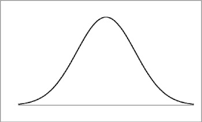

Adaptive Kernel
The bandwidth is adaptive
The bandwidth at each point is set such that perplexity is fixed
Perplexity = $2^{H(P\left(i,∗\right))}$= effective # neighbors
Gaussian Kernel
stddev = σ

Slide 7
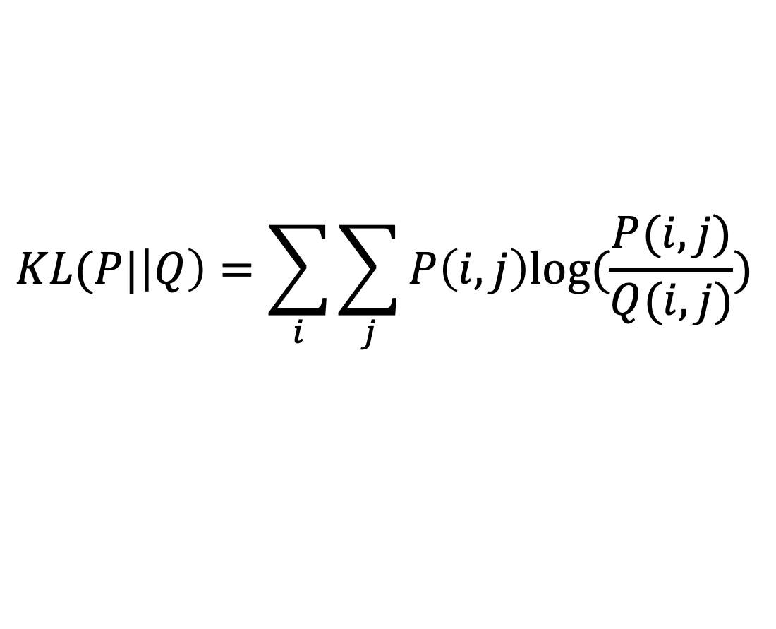
KL-Divergence
Minimize divergence between probability distributions
Divergence is not symmetric like a distance
Kullback-Liebler divergence: Measures amount of information gained when updating one distribution to another
High dimensional neighbor probability
$$KL(P|\left|Q\right)=\sum_{i}{\sum_{j}{P\left(i,j\right)log⁡(\frac{P(i,j)}{Q(i,j)})}}$$
Low dimensional neighbor probability

Slide 8
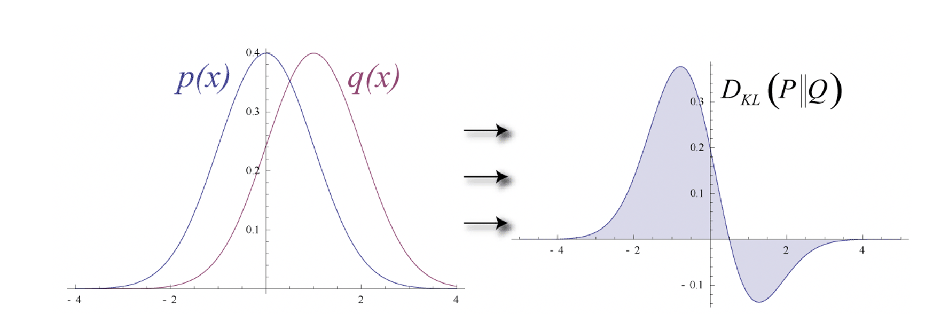
KL-Divergence Example
From Wikipedia
Divergence is the area under this curve

Slide 9
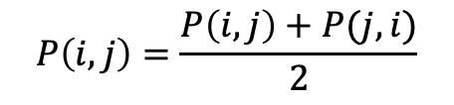
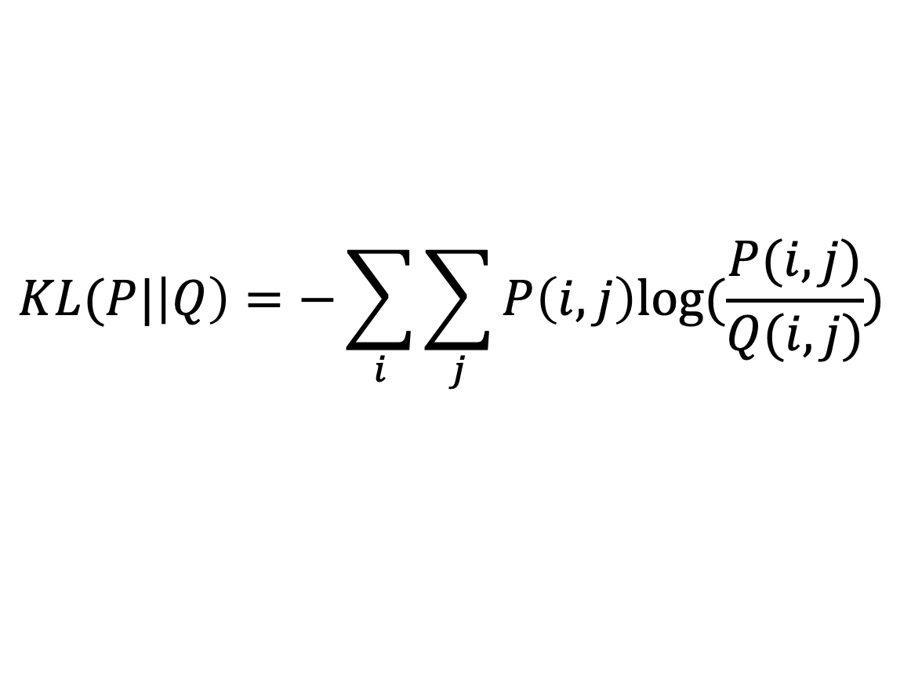
Symmetrized Cost in Divergence
$$P\left(i,j\right)=\frac{P\left(i,j\right)+P(j,i)}{2}$$
$$KL(P|\left|Q\right)=−\sum_{i}{\sum_{j}{P\left(i,j\right)log⁡(\frac{P(i,j)}{Q(i,j)})}}$$
1. Start with a random embedding in 2-3 dimensions
2. Move each point based based on Stochastic Gradient Descent

Slide 10
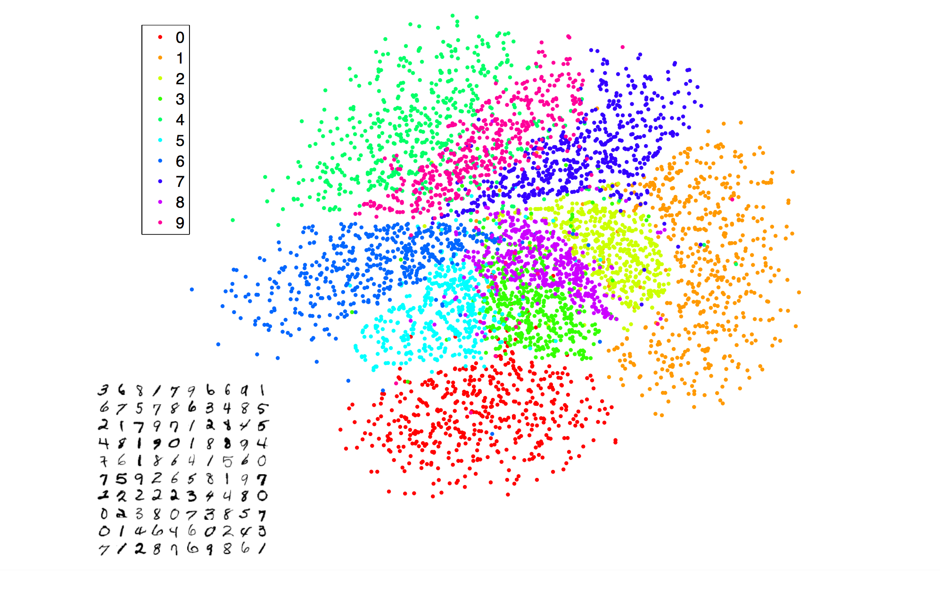
SNE on MNIST handwritten Digits

Slide 11
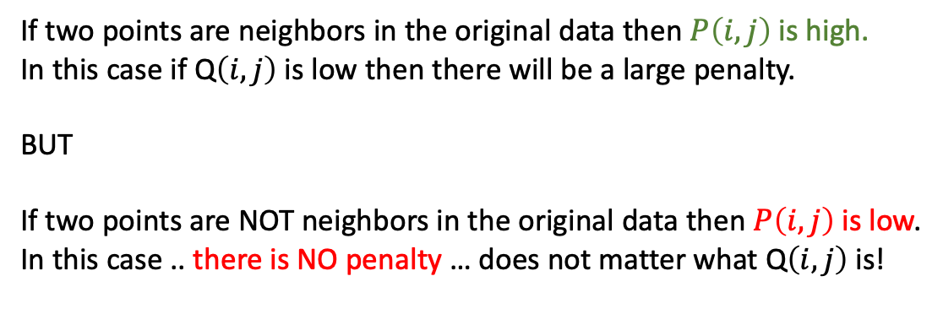
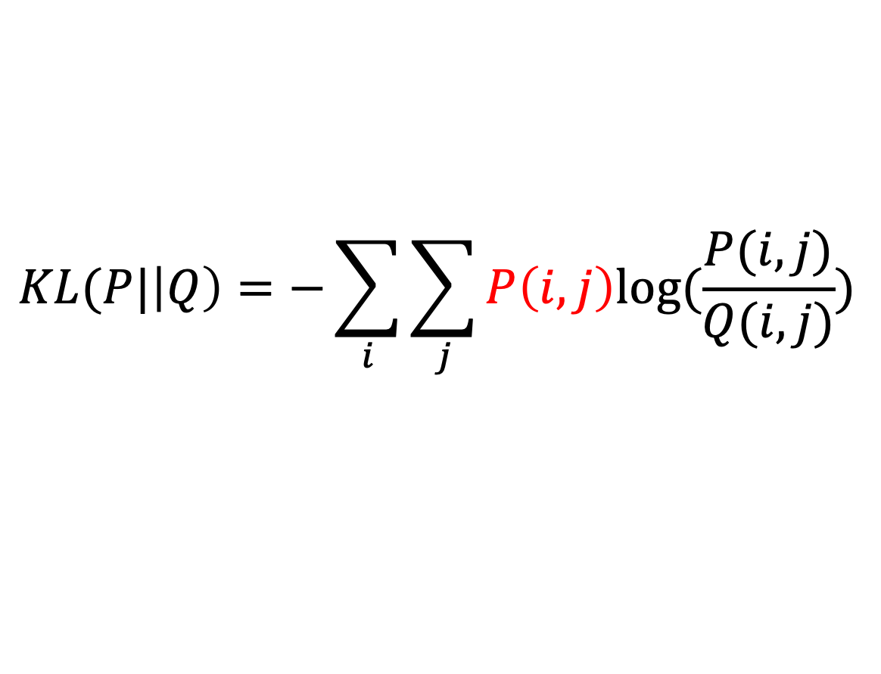
Small problem…
$$KL(P|\left|Q\right)=−\sum_{i}{\sum_{j}{P\left(i,j\right)log⁡(\frac{P(i,j)}{Q(i,j)})}}$$
If two points are neighbors in the original data then $P\left(i,j\right)$ is high.
In this case if Q$\left(i,j\right)$ is low then there will be a large penalty.
BUT
If two points are NOT neighbors in the original data then $P\left(i,j\right)$ is low.
In this case .. there is NO penalty … does not matter what Q$\left(i,j\right)$ is!

Slide 12
SNE to tSNE
Notice that the classes in MNIST were not separated or “pushed apart” in SNE
To remedy this, we can try to increase the tail of the distribution
but not change the penalty

Slide 13
Gaussian Distribution: high dim
T-distribution: low dim
T-Distribution “cares” more about far away points so will push them apart

Slide 14
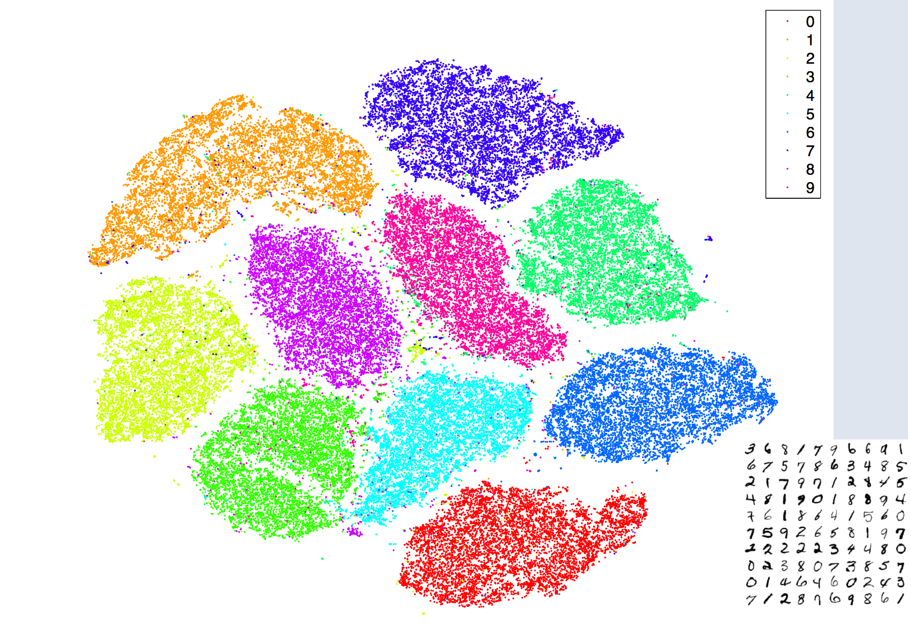
MNIST: SNE t-SNE clusters overlapped clusters are separated clearly

Slide 15
Comparison to Diffusion Maps, PHATE
Does not use diffusion, random walking
Does not use eigendecomposition
Does not use MDS or distance preservation
Does try to match near neighbors using KL divergence

Slide 16
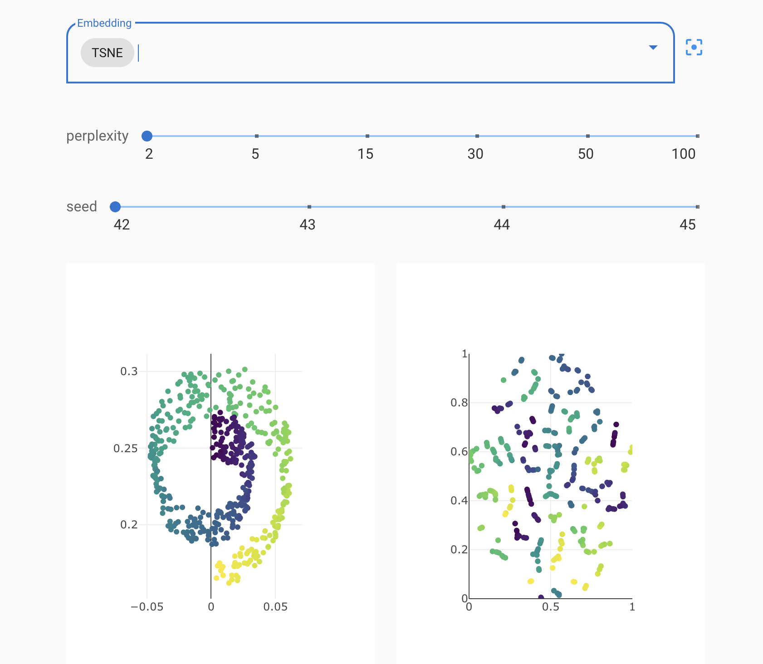
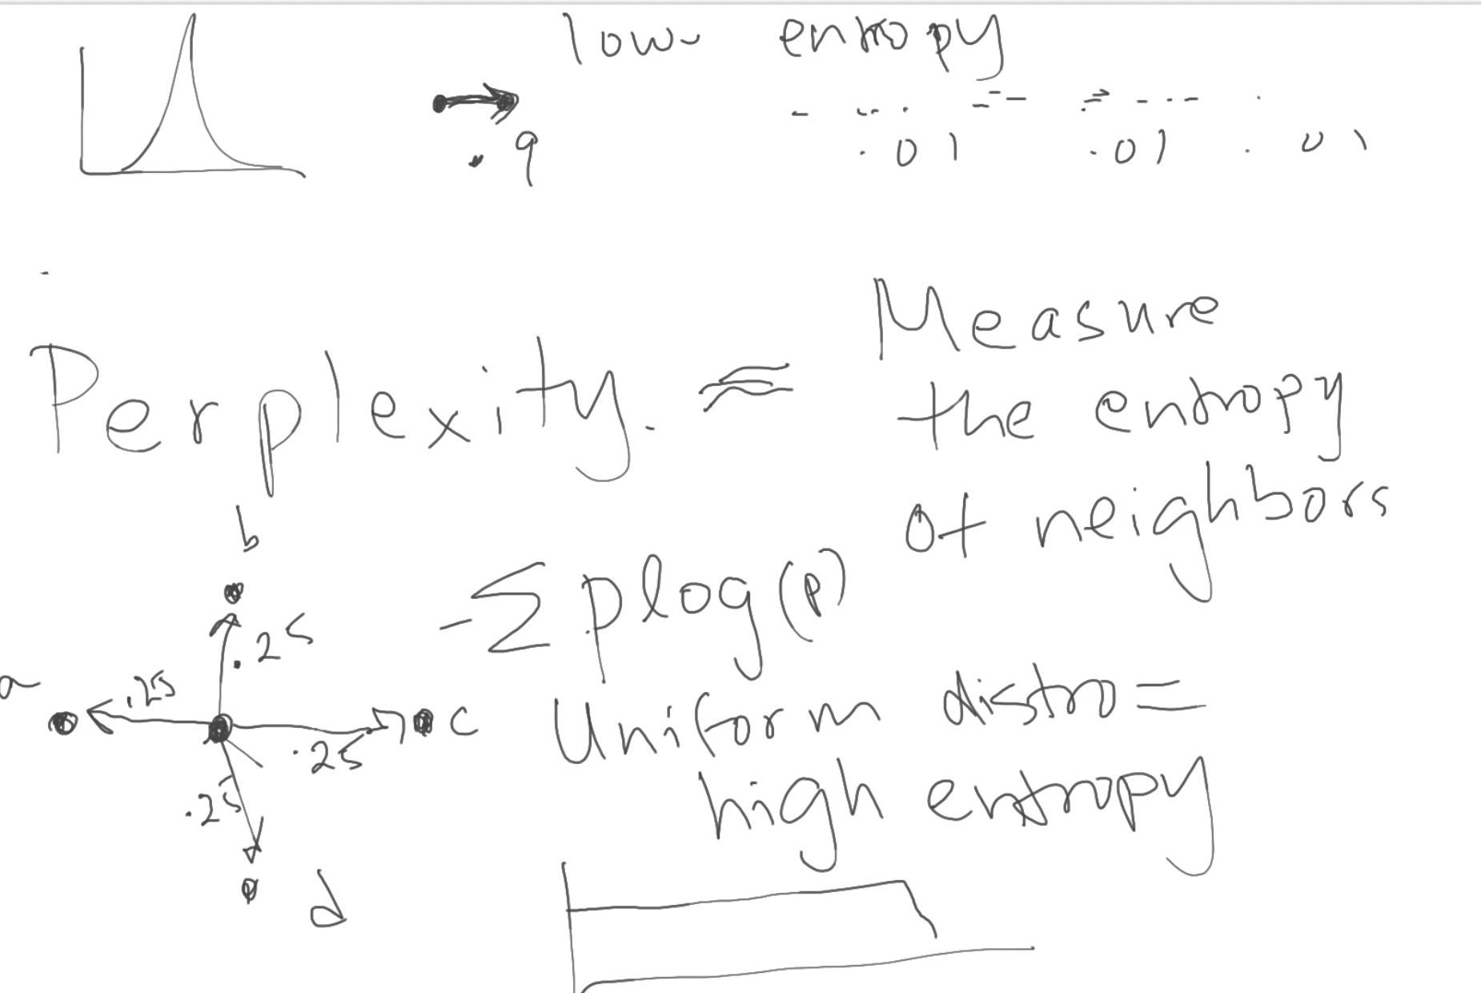
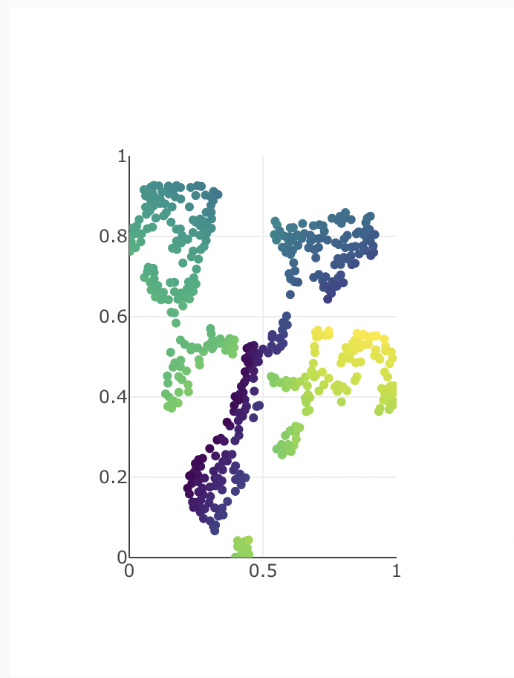
t-SNE
seed: random initialization
Perplexity = 2
Perplexity = 30
perplexity: measure of entropy
when distribution is uniform, achieve highest entropy
when distribution us peaky, achieve low entropy
UMAP: condense clusters more than t-SNE, but they both can’t denoise
Notes:
t-SNE:
perplexity: measure of entropy
when distribution is uniform, achieve highest entropy
when distribution us peaky, has low entropy
UMAP: condense clusters more than t-SNE

